Slide 1


Pál Rakonczai, László Varga, András Zempléni
Copula fitting to time-dependent data, with applications to wind speed maxima
Eötvös Loránd University
Faculty of Science
Institute of Mathematics
Department of Probability Theory and Statistics

Slide 2
Outline
Copulae
Goodness-of-fit tests
Bootstrap methods
Serial dependence
Applications to wind speed maxima

Slide 3
1. Copulae
C is a copula, if it is a d-dimensional random vector with marginals ~ Unif [0,1]
Existence (Sklar’s Theorem): to any d-dimensional random variable X with c.d.f. H and marginals F_{i} (i=1,...,d) there exists a copula C :
H( x₁, …, x_{d} ) = C ( F₁(x₁), …, F_{d}(x_{d} ) )
Uniqueness: if F_{i} are continuous (i=1,...,d)
Separation of the marginal model and the dependence

Slide 4
1. Copulae – Examples
Elliptical Copulae – copulae of elliptical distributions
  Gaussian: X ~ N_{n}(0,Σ)
  where Φ: c.d.f. of N(0,1)
  Student’s t: X ~
  where t_{v}: c.d.f. of Student’s t distribution with v degrees of freedom

Slide 5
1. Copulae - Examples
Archimedean Copulae
Copula generator function:
ϕ is continuous, strictly decreasing and ϕ(1)=0.
d-variate Archimedean copula:
  Gumbel: where
  Clayton: where

Slide 6
1. Copulae - Examples

Slide 7
2. Goodness-of-fit tests in one dimension
Estimation of the model parameter
Goodness-of fit test:
  Cramér-von Mises tests:
      F_{n}: empirical c.d.f.
      F: c.d.f.
      Φ : weight function
        Anderson-Darling:
  Critical value – simulation:
      Simulate a sample from the copula model C_{θ} under H₀
      Re-estimate by ML-method
      Calculate the test statistics
      Repetition and estimation of p values

Slide 8
2. Goodness-of-fit tests in more dimensions
Probability integral transformation (PIT) – mapping into the d-dimensional unit cube:
~H ~C, for i=1,...,n
Kendall’s transform: (K function)
Advantage: one-dimensional
  Example: Archimedean copulas:
  where

Slide 9
2. Goodness-of-fit tests in more dimensions
Empirical version:
where
Kendall’s process:
      favorable asymptotic properties
Cramér-von Mises type statistic:
        where Φ : weight function

Slide 10
3. Serial dependence
Let X₁, X₂, ..., X_{n} be univariate stationary observations; EX_{i} =μ , Var(X_{i} )=σ².
If X₁, X₂, ..., X_{n} are i.i.d., then
Serial dependence → higher variance
Effective sample size (n_{e}):
    where : estimated variance ← bootstrap

Slide 11
4. Bootstrap methods - Bootstrap intro
Efron (1979)
Let X₁, X₂, ... be i.i.d. random variables with (unknown) common distribution F
  X_{n}={X₁, ..., X_{n}} random sample
  T_{n}=t_{n}(X_{n}; F) random variable of interest, it’s distribution: G_{n}
Goal: approximation of the distribution G_{n}
Bootstrap method:
  For given X_{n}, we draw a simple random sample of size m (usually m ≈ n)
  Common distribution of ’s:
  Repetition

Slide 12
4. Bootstrap methods - CBB
Nonparametric bootstrap (sample size: n)
  Block bootstrap
    Circular block bootstrap (CBB)
Let
For some m, let i₁, i₂ ..., i_{m} be a uniform sample from the set {1, 2, ..., n}
For block size b, construct n’=m·b (n’≈n) pseudo-data: for j=1,...,b
Functional of interest, e.g. bootstrap sample mean:

Slide 13
4. Bootstrap methods – Block-length selection
D.N.Politis-H. White (2004): automatic block-length selection
Minimalize:
where and
g(.): spectral density function
R(.): autocovariance function
Optimal block size:
Estimation of G and D

Slide 14
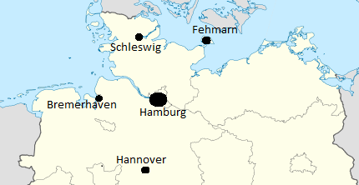
5. Applications to wind speed maxima
Sample: n = 2591 observations of weekly wind speed maxima for 5 German towns
Automatic block-length
selection results:
meteorologically no sense

Slide 15
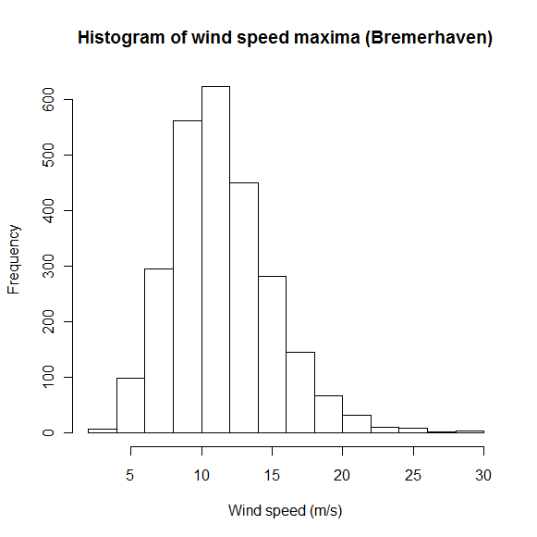
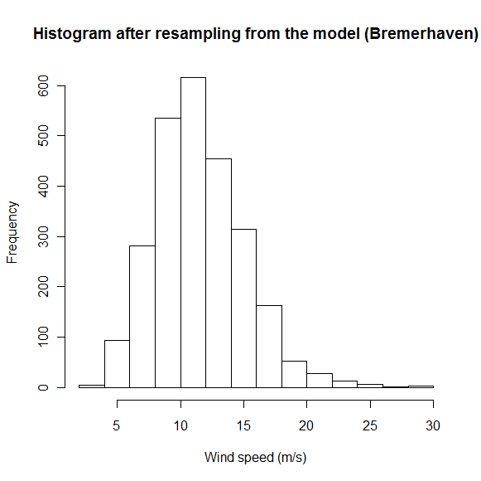
5. Applications to wind speed maxima
Method:
  Fitting AR(1) modell to the data:
  , Z_{t} ~Extreme value distr.
  Calculation of the theoretical from AR(1) parameters:
  b* optimal block size: where the simulated variance of the mean first crosses the theoretical value

Slide 16
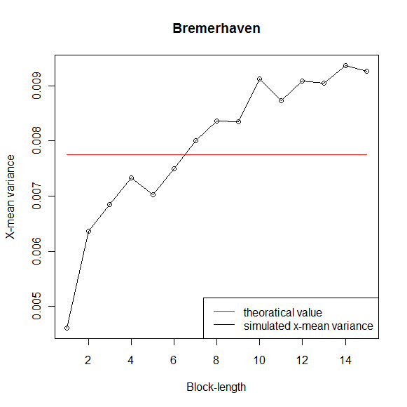
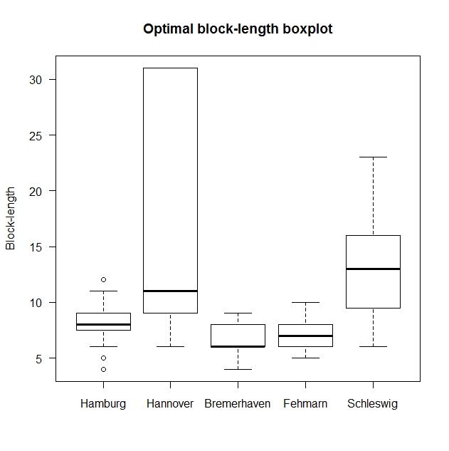
5. Applications to wind speed maxima
    Bootstrap simulation results
    b* = 6

Slide 17
5. Applications to wind speed maxima
Bootstrap simulation results

Slide 18
5. Applications to wind speed maxima
Bremerhaven & Fehmarn
Gumbel
Clayton
0.8
0.8
0.4
0.4
0.0
Empirical K
0.0
Empirical K
Theoretical K
Theoretical K
0.0
0.2
0.4
0.6
0.8
1.0
0.0
0.2
0.4
0.6
0.8
1.0
Gauss
Student-t
0.8
0.8
0.4
0.4
0.0
Empirical K
0.0
Empirical K
Theoretical K
Theoretical K
0.0
0.2
0.4
0.6
0.8
1.0
0.0
0.2
0.4
0.6
0.8
1.0

Slide 19
5. Applications to wind speed maxima
Bremerhaven & Schleswig
Gumbel
Clayton
0.8
0.8
0.4
0.4
0.0
Empirical K
0.0
Empirical K
Theoretical K
Theoretical K
0.0
0.2
0.4
0.6
0.8
1.0
0.0
0.2
0.4
0.6
0.8
1.0
Gauss
Student-t
0.8
0.8
0.4
0.4
0.0
Empirical K
0.0
Empirical K
Theoretical K
Theoretical K
0.0
0.2
0.4
0.6
0.8
1.0
0.0
0.2
0.4
0.6
0.8
1.0

Slide 20
5. Applications to wind speed maxima
Fehmarn & Schleswig
Gumbel
Clayton
0.8
0.8
?
?
t
0.4
K
0.4
0.0
Empirical K
0.0
Empirical K
Theoretical K
Theoretical K
0.0
0.2
0.4
0.6
0.8
1.0
0.0
0.2
0.4
0.6
0.8
1.0
Gauss
Student-t
0.8
0.8
?
?
t
0.4
K
0.4
0.0
Empirical K
0.0
Empirical K
Theoretical K
Theoretical K
0.0
0.2
0.4
0.6
0.8
1.0
0.0
0.2
0.4
0.6
0.8
1.0

Slide 21
5. Applications to wind speed maxima
Prediction regions (Bremerhaven & Fehmarn)
25
block=1 lower bound
block=7 lower bound
Wind speed (m/s)
block=30 lower bound
20
block=1 upper bound
block=7 upper bound
block=30 upper bound
15
10
5
Pred. regions: 50-95-99.8%
lower(5%) bounds
0
upper(95%) bounds
0
5
10
15
20
25
30
Wind speed (m/s)

Slide 22
Final remarks
Conclusions
Copula choice is important
Serial dependence largely influences the critical values of GoF tests
Block size does not have a major impact on the estimated prediction region
Future work
Multivariate effective sample size
Parametric bootstrap
Acknowledgement
We are grateful to the Doctoral School of Mathematics of ELTE for supporting L. Varga’s participation at SMTDA Conference.

Slide 23

Thank you for the attention

Slide 24
References
P. Rakonczai, A. Zempléni: Copulas and goodness of fit tests. Recent advances in stochastic modeling and data analysis, World Scientific, pp. 198-206, 2007.
S.N. Lahiri: Resampling Methods for Dependent Data. Springer, 2003.
D.N.Politis, H.White: Automatic Block-Length Selection for the Dependent Bootstrap. Econometric Reviews, Vol. 23, pp. 53-70, 2004.
P. Embrechts, F. Lindskog, A. McNeil: Modelling Dependence with Copulas and Applications to Risk Management. Department of Mathematics, ETHZ, Zürich, 2001.
L.Kish: Survey Sampling, J. Wiley, 1965.

